Slide 1
Green IT Business Dimensions
Dimension Process
Dimension People

Slide 2
Green IT Business Dimensions
Factors that changes or transforms organization
These Factors Consists :
Economy
Technologies
Processes
People

Slide 3
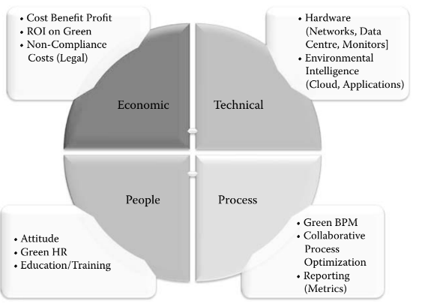

Slide 4
Dimension : Processes
“how” things are done within an organization
Most visible one and used to judge level of ecological responsibility
Key elements are Green BPM, Collaborative business process optimization and reporting (with metrics)
Green BPM made up of Process Management and Process Reengineering

Slide 5
Dimension : Processes(cont.)
Process reengineering : Fundamental Rethinking and Redesign of processes to achieve improvements
Studies and optimizes to improve green credentials
Maintenance process and precautionary action can help in reducing carbon generation

Slide 6
Dimension : People
Depends on individual employee and customer making it more complex of all.
studied to in great depths, focuses on attitudes of individuals and environment
Best driven from the top of organization to grass-root level
Involving Senior management in early stage of green initiative is vital
Key work is to making stakeholders aware of importance of initiative and promoting it
major differentiator between two organizations

Slide 7
THANK YOU !!
Shubham pawar (256)
Suraj pawar (267)
Shubham Surve (273)

